Slide 1

Introduction to Go
Commitmas vBrownBag
Anthony Chow
Twitter: @vCloudernBeer
GitHub: vCloudernBeer
Blog: http://cloudn1n3.blogspot.com
Dec 30, 2015

Slide 2


Why do I want/need to learn Go?
Developer:
  Always good to know something new
  Open source projects written in Go
  Sharpen existing programming skill
Operator:
  Software defined Data Center
  Automation/Scripting
  At least know how to read the code

Slide 3
A little bit of Go
Address specific problems occurred @ Google on software development and deployment
Rob Pike: Go is a
  Complied
  Concurrent
  Garbage-collected
  Statically typed language developed at Google around 2007 for efficiency, scalability and productivity
Very developer friendly
  Easy for debugging - multiple variable assignment
  Built-in packages - JSON, networking and web app.
  Goroutines - take advantage of multicore hardware
  GoTools – rich ecosystem e.g. gofmt, godoc, golint …
  Go test – support automated unit testing or benchmarking
Feature set dictates the “Go way”

Slide 4
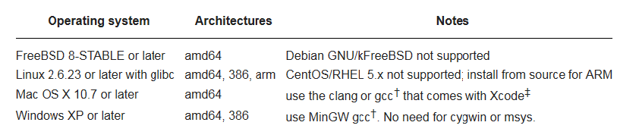
Installation
https://golang.org/doc/install
  Windows
  Mac
  Linux

Slide 5
Go Terminologies
Important to know:
  Able to understand the language
  Able to read compile error and warning.
Terms:
  Package
  Block - Delimiter {}, (), []
  Scope
  Variable
  Type – type, reference
Features:
  Memory management - garbage collection, stack size
  Slice – prefer over array
  Map – similar to the “dict” in Python (key-value store)
  Composition (no inheritance)
  Concurrency
  Interface
  Channels

Slide 6
Basic programming
Data declaration
Assignment
If-then-else
Iteration

Slide 7
Demo #1

Slide 8
Object Oriented Programming?
Go is object oriented
Go is NOT object oriented

Slide 9
Demo #2

Slide 10
Go resources
Go Playground
http://tour.golang.org/welcome/1
https://golang.org/doc/
http://dave.cheney.net/resources-for-new-go-programmers
Use the keyword Golang to search with your favorite search engine.
YouTube
Local Meetup

